Slide 1
DSCI-531: Fairness in Artificial Intelligence
Ethics in AI
Dr. Keith Burghardt

Slide 2
Formally defining ethics
Ethics : how to live the best life (for you, for society, etc.)
How do we identify a good life (one worth choosing)?
Moral principles that govern behavior
E.g., “do unto others as you have them do unto you”

Slide 3
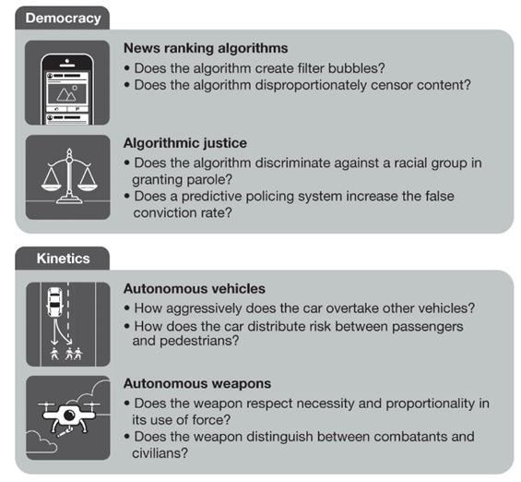
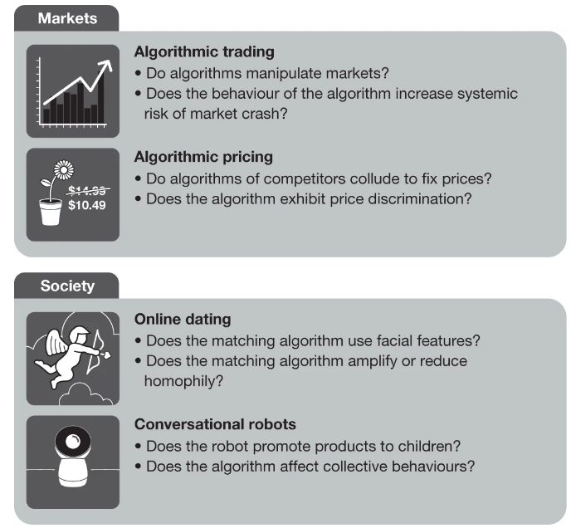
AI’s Broad Impact

Slide 4
Ethics and AI
Individual benefits/harms
Well-designed and well-used AI can create individual benefits
Reduced effort - e.g., AI can plan for you
Greater efficiency - e.g., logistics; better distribution of goods
Easier access to services - e.g., chat bots
Poorly designed AI can create individual harms
Toxic effects - e.g., increasing hate speech
Reduced efficiency - e.g., inability to account for low-probability high risk events
AI reflects the values that we ‘bake in’ to it with our design.
AI language models (e.g., ChatGPT) bake in stereotypes
AI trained on human decisions -> human ethics could play a role
Societal benefits/harms:
Facebook, Google, Amazon, Apple, and Microsoft have more global political influence than many states and nations.

Slide 5
AI makes ethical decisions
Positive/negative impacts of AI unevenly distributed
AI can choose ‘winners’ and ‘losers’ or magnifying existing inequalities
Who benefits from AI? e.g., AI automation is profitable for companies.
Who is harmed? e.g., AI automation could increase income inequality.
AI fairness: How do we know who is harmed by AI, who benefits?
AI justice: How do we ensure that access to the benefits of AI, and exposure to its harms, are distributed in the right way?

Slide 6
Ethically significant benefits of AI
Human understanding – AI can make sense of data to help us better understand the world
E.g., drug or material discoveries
Social and economic efficiency - once we understand the world, we can design or intervene in its systems to improve their functioning
Predictive accuracy & personalization - more precisely tailor actions to be effective in achieving good outcomes for specific individuals, groups, and circumstances.

Slide 7
Dimensions of harm: harms to privacy & security
AI models can reveal private & intimate data
Language models can output copyrighted text, code, SSNs, addresses, etc.
Image generators (DALL-E, Stable Diffusion, etc.) can output images based on copyrighted work

Slide 8
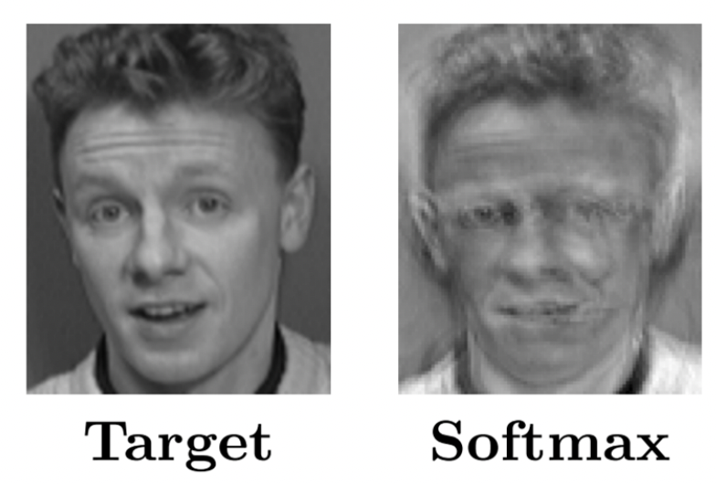
AI model to recreate an image label
Model may map face image to name
Reverse-engineering this model (finding what face has highest name confidence) can reveal the face associated with a name
https://www.mdpi.com/2076-3417/9/5/909

Slide 9
Dimensions of harm: harms to transparency, autonomy
Harms to transparency & autonomy – AI models can be non-transparent and make decisions without our explicit permission
Transparency: AI models can be black boxes (we do not know how they work)
E.g., why were you denied a loan?
Autonomy:
Reduced situational awareness (what is happening when things go wrong)
737 MAX 8
No informed consent (important decisions made without our knowledge)
Recommending harmful content

Slide 10
Dimensions of harm: harms to fairness & justice
AI models can enhance unfair and unjust decisions
Non-random errors (e.g., more errors for African Americans)
Discrimination (harm to one demographic group)
Especially important for big decisions (who to hire, who is given bail, etc.)

Slide 11
Other dimensions of AI
Explainability – How did the system arrived at its decision/outcome?
e.g., why a loan was denied?
Stability – Will AI make consistent decisions?
E.g., is model sensitive to initial conditions? Will AI lead to similar outcomes in each deployment?
Are decisions inconsistent with small data changes?
Economic inequality – Income inequality has grown as AI automation replaced routine work.
🡪 Trustworthy AI

Slide 12
Ethical Challenges in AI

Slide 13
Ethical challenges
Appropriate data collection and use
Data privacy: how to respect the purpose for, and context within which, certain data was shared with us or generated for us?
How to avoid unwarranted or indiscriminate data collection
Consent: do data subjects know data is shared?
Are data subjects compensated for their data?
What control or rights should data subjects have over their data? (cf. GDPR: https://gdpr-info.eu/)
Data storage, security, and responsible data stewardship
How to anonymize data? How to keep it secure? Will these procedures create undue burdens? Will they help?
What are the ethical risks of long-term data storage?

Slide 14
Ethical challenges (cont.)
Data clearing and relevance
How ‘dirty’ (inaccurate, inconsistent, incomplete, or unreliable) is our data?
What are our established tools and practices for scrubbing dirty data?
Have we considered the diversity of the data sources and/or training datasets?
Identifying and addressing ethically harmful data biases
What harmful human biases are reflected in our data? Are these explicit (e.g., hate speech) or implicit (e.g., assuming doctors are men)?
How to audit or eliminate data biases?
What biases are useful (e.g., heuristics) versus harmful?
Who might be harmed?
How will this affect individuals or society?

Slide 15
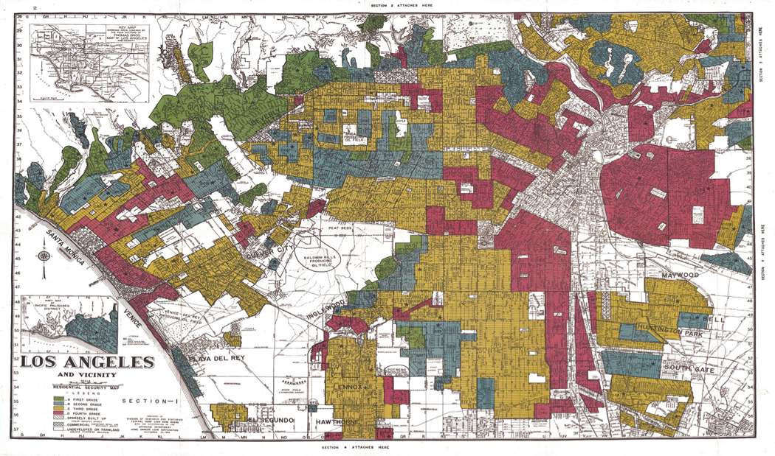
“Redlining” – discrimination by race zipcode

Slide 16
Ethical challenges
Validation and testing of data models & analytics
When will models stop working (validity) e.g., adding non-random noise to data? When will the analysis make incorrect conclusions (e.g., Simpson’s paradox)?
How can we test our data analytics and models to ensure their reliability across new, unexpected contexts? (e.g., self-driving cars at night time)
Human accountability in data practices & systems
Who will be designated as responsible for each aspect of ethical data practice?
Who should and will be held accountable?
The personal, social, business impacts of data practice
Have we fully considered how our data/data practice or system will be used, and how it might impact data subjects or other parties later on?
Has the testing of the practice taken into account how its impact might vary?

Slide 17
How does AI become unfair?

Slide 18
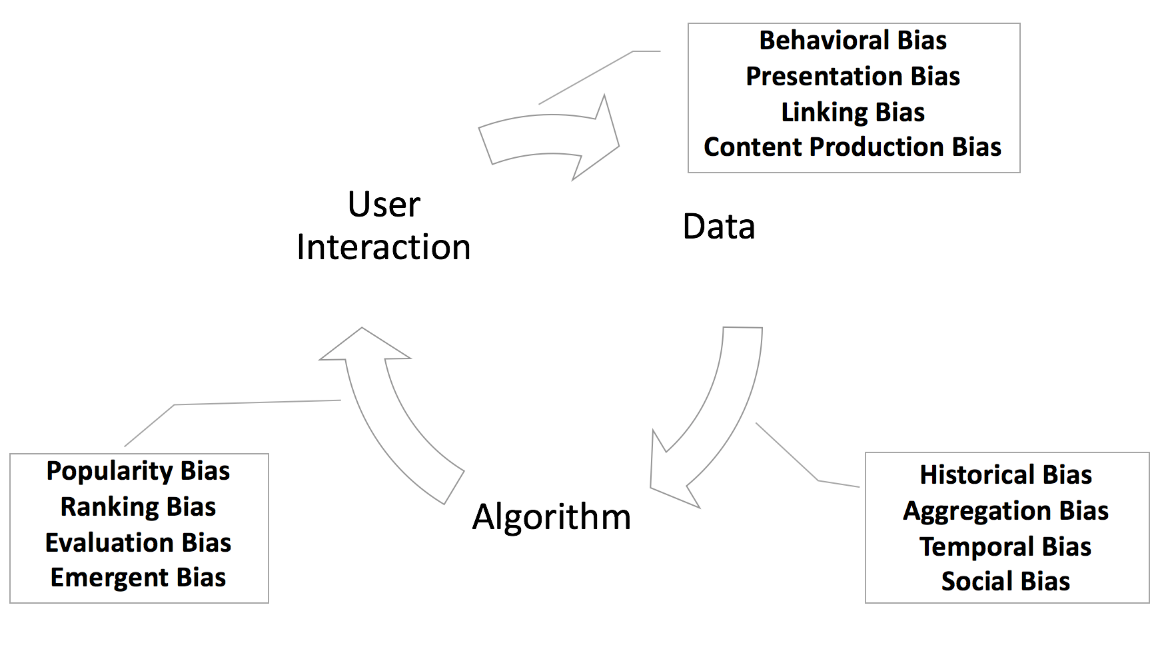
Socially-embedded AI
Mehrabi, N., Morstatter, F., Saxena, N., Lerman, K., & Galstyan, A. (2021). A survey on bias and fairness in machine learning. ACM Computing Surveys (CSUR), 54(6), 1-35.

Slide 19
Ethical issues in data
Ethical issues are everywhere in the world of data, because data’s collection, analysis, transmission and use can and often does profoundly impact the ability of individuals and groups to live well.
“big data analytics have the potential to eclipse longstanding civil rights protections in how personal information is used in housing, credit, employment, health, education, and the marketplace.”
White House report Big Data: Seizing Opportunities, Preserving Values, 2014

Slide 20
Legally problematic when harms protected classes
US Federal laws define protected classes to include:
Race.
Color.
Religion.
National origin or ancestry.
Sex/Gender.
Age.
Physical or mental disability.
Veteran status.
Genetic information.
Citizenship.

Slide 21
What is bias?
prejudice in favor of or against one thing, person, or group compared with another, usually in a way considered to be unfair.
a systematic distortion of a statistical result due to a factor not allowed for in its derivation.
(cognitive) a systematic error in thinking that occurs when people are processing and interpreting information in the world around them and affects the decisions and judgments that they make.
bi·as
/ˈbīəs/

Slide 22
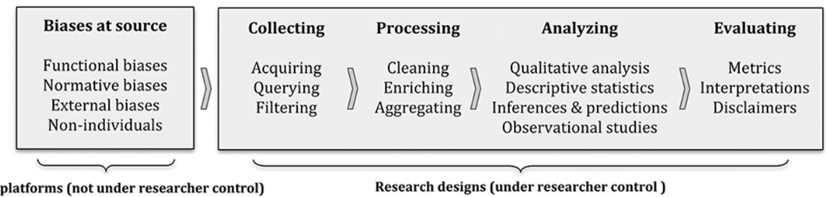
How can AI discriminate?
Biases in source data
Historical bias: Prejudiced are “baked into” data, systematically distorting population characteristics
Behavioral bias: Systematic distortions in user behavior across platforms or contexts, or across users represented in different datasets.
Self-selection and response bias. Studies relying on self-reports may be biased due to what users choose to report or share about, when they report it,
Peak-end effect: People are more likely to report about extreme or positive experiences than common or negative experiences
Olteanu, A., Castillo, C., Diaz, F., & Kıcıman, E. (2019). Social data: Biases, methodological pitfalls, and ethical boundaries. Frontiers in Big Data, 2, 13.

Slide 23
How can AI discriminate?
Data collection biases
Sampling bias: Systematic distortion introduced by the selection of data sources, or by the way in which data from these sources are acquired and prepared.
Filtering bias: Characteristics of partially-observed populations may be systematically different from their actual characteristics
Olteanu, A., Castillo, C., Diaz, F., & Kıcıman, E. (2019). Social data: Biases, methodological pitfalls, and ethical boundaries. Frontiers in Big Data, 2, 13.

Slide 24
How can AI discriminate?
Data processing biases
Data cleaning: Correct errors, remove outliers, fill in missing or incomplete values. Researcher assumptions can blindside & lead to incorrect or misleading data patterns, for example
Data normalization: Choice of data standardization may affect results
Data aggregation: Aggregate data to reduce noise, make it more manageable, but may lose information and introduce distortions
Olteanu, A., Castillo, C., Diaz, F., & Kıcıman, E. (2019). Social data: Biases, methodological pitfalls, and ethical boundaries. Frontiers in Big Data, 2, 13.

Slide 25
How can AI discriminate?
Biases when Analyzing the Data: Choices made while modeling data can raise concerns
Confounding: Simpson’s paradox can distort descriptive statistics & regression analysis
Reproducibility: using data as a source of hypotheses rather than a tool to test them;
testing multiple hypotheses until a significant, positive result is found.
Model tuning: choice of model complexity, parameters, regularization functions
Information leakage: Need to separate testing and training data
Olteanu, A., Castillo, C., Diaz, F., & Kıcıman, E. (2019). Social data: Biases, methodological pitfalls, and ethical boundaries. Frontiers in Big Data, 2, 13.

Slide 26
How can AI discriminate?
Evaluating Models, Results
Metrics: The choice of metrics shapes a research study take-aways.
Fairness: Assessing fairness is challenging and many measures cannot be simultaneously satisfied.
Researcher bias: results can be overlooked due to the personal blind spots of those working with data
Olteanu, A., Castillo, C., Diaz, F., & Kıcıman, E. (2019). Social data: Biases, methodological pitfalls, and ethical boundaries. Frontiers in Big Data, 2, 13.

Slide 27
Case study: COMPAS

Slide 28
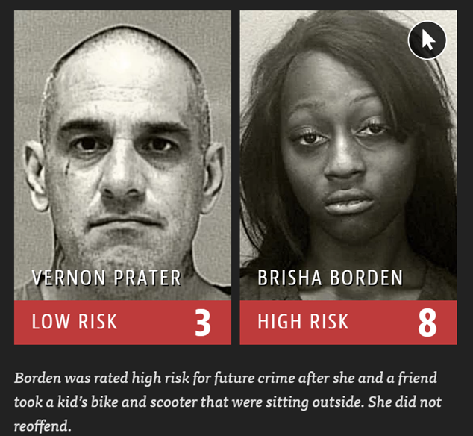
Bias in automated criminal risk assessment COMPAS tool systematically gives black defendants higher risk scores for future recidivism
https://www.propublica.org/article/machine-bias-risk-assessments-in-criminal-sentencing

Slide 29

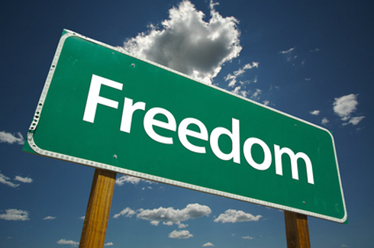
Automated risk assessment
Increasingly common in the judicial system in the US
Algorithm computes a score predicting the likelihood a defendant will commit a crime in the future (will recidivate).
High probability to commit another crime
Algorithm
(COMPAS)
Individual
Features
Prediction
Low probability to commit another crime

Slide 30
Benefits and harms of risk scores
Increase efficiency and reduce prejudice
Used by judges to inform decisions about bail, sentencing, parole, conditions for release, etc.
Hoped to mitigate existing sources of bias in human judgments
In 2014 US Attorney General Eric Holder warned risk scores may be injecting bias into the courts
“Although these measures were crafted with the best of intentions, I am concerned that they inadvertently undermine our efforts to ensure individualized and equal justice. They may exacerbate unwarranted and unjust disparities that are already far too common in our criminal justice system and in our society.”

Slide 31
COMPAS
Correctional Offender Management Profiling for Alternative Sanctions
Assigns defendants risk scores between 1 and 10 that indicate how likely they are to commit a violent crime based on more than 100 factors, including age, sex and criminal history.
Defendants with scores of 7 reoffend at twice the rate as those with scores of 3.
Help judges make decisions about whether to release a defendant or hold them in jail while waiting for trial
Deployed before it was rigorously tested

Slide 32


ProPublica study
Data: 7000 people arrested in Broward County, FL (2013-2014)
COMPAS algorithm predicts whether a defendant will commit a crime within next 2 years
Prior Offense | 1 attempted burglary
LOW RISK | 3
Subsequent Offenses | 3 drug possessions
Prior Offense | 1 resisting arrest without violence
HIGH RISK | 10
Subsequent Offenses | None
 | Did commit a crime | Did not commit a crime
High risk (will commit a crime) | True Positives | False Positives
Low risk (will not commit a crime) | False Negatives | True Negatives

Slide 33
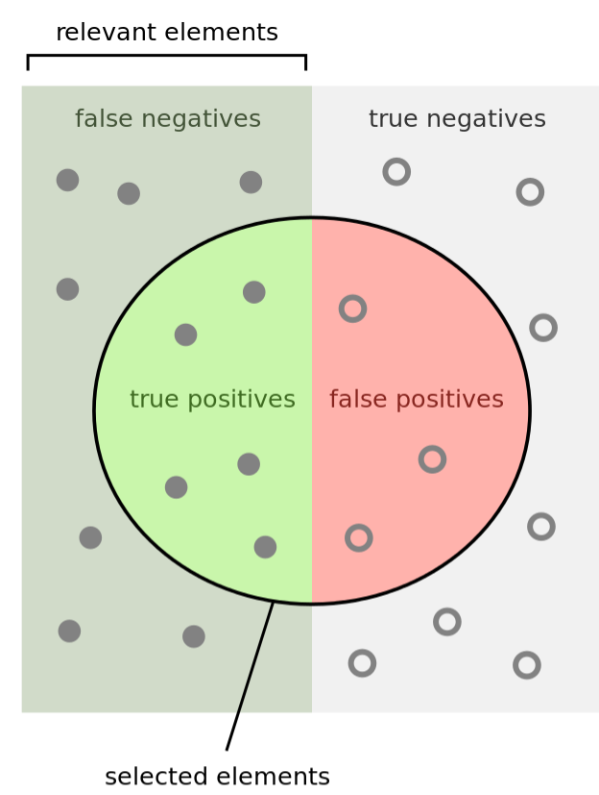
Measuring classification performance
 | Did commit a crime | Did not commit a crime
Will commit crime | True Positives (TP) | False Positives (FP)
Will not commit a crime | False Negatives (FN) | True Negatives (TN)
Accuracy = Number of correct predictions/Total predictions
Accuracy = TP + TN / (TP+TN+FP+FN)
Precision = TP / (TP + FP)
Recall = TP / (TP + FN )
Sensitivity = TP rate = TP / (TP + FN)
Specificity = TN rate = TN / (TN + FP)
False positive rate = FP / (TN + FP) = 1 - Specificity

Slide 34
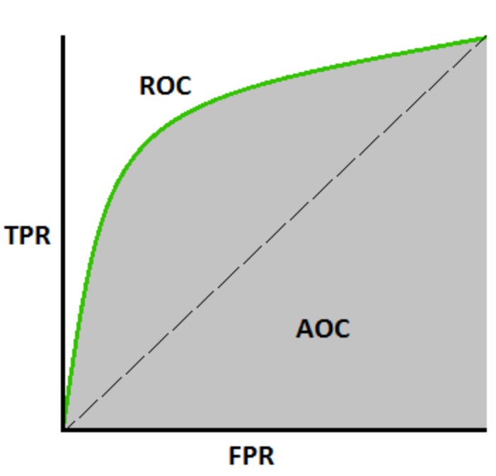
Measuring classification for non-binary outcomes
COMPAS makes a prediction p(y) in [1, 10]
Thresholding φ
If p(y) > φ then defendant will commit a crime again
Otherwise, defendant will not commit a crime
Converts to a binary prediction
AUC – Area under ROC curve
How well a model can distinguish between classes.
Probability the model will score a randomly chosen positive class higher than a randomly chosen negative class
φ9
φ2
φ1

Slide 35
COMPAS performance
Accuracy
20% accuracy for violent crimes
61% when all crimes are considered
Asymmetry of mistakes: who bears the costs?
False negatives
False positives
Racial disparity: different types of mistakes for whites and blacks

Slide 36
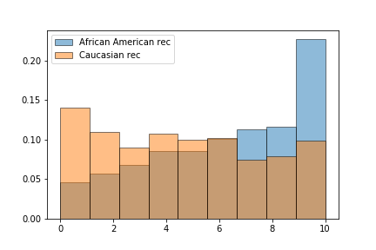
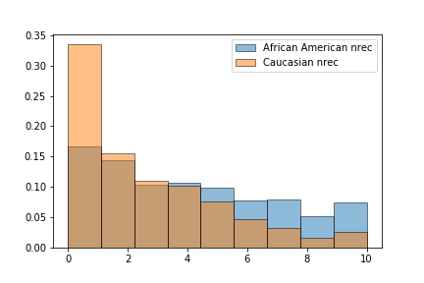
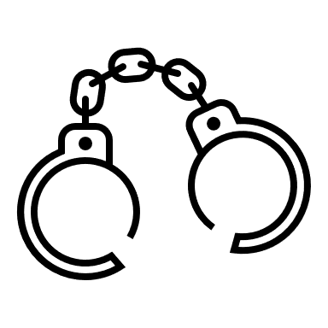

Racial disparities in COMPAS risk scores
Significant racial disparities: different types of mistakes for whites and blacks
False Positive rate high for blacks:
Algorithm falsely flagged black defendants as future criminals at 2X the rate for white defendants
False Negative rate high for whites
White defendants were mislabeled as low risk more often than black defendants.
This disparity cannot be explained by prior crimes, the type of crimes, their age and gender
Defendants who committed another crime
Defendants who did not commit another crime
Risk score
Risk score

Slide 37
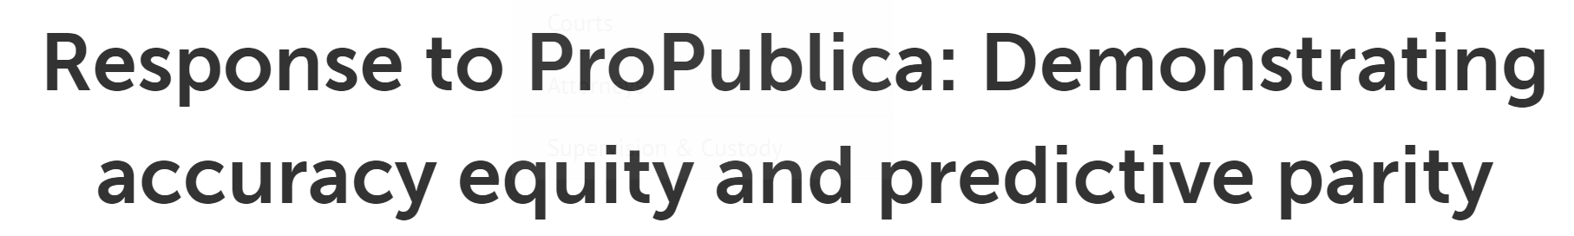
Northpointe response
ProPublica focused on classification statistics that did not take into account the different base rates of recidivism for blacks and whites.
When the correct classification statistics are used, the data does not substantiate the ProPublica claim of racial bias towards blacks.
The interpretation of the results in the samples used by ProPublica demonstrate that the General Recidivism Risk Scale (GRRS) and Violent Recidivism Risk Scale (VRRS) are equally accurate for blacks and whites.

Slide 38
Northpointe response
COMPAS has predictive parity and accuracy equity
Classifier has predictive parity if it has similar predictive values for two different groups (blacks and whites),
I.e., Probability of recidivism given a high risk score is similar for blacks and whites.
A classifier has accuracy equity if it can discriminate recidivists and nonrecidivists equally well for two different groups (blacks and whites).
Use area under the receiver operating characteristic (ROC) curve (AUC) to quantify discriminative ability. The ROC curve is a plot of Sensitivity (tpr) and Specificity (tnr) for all possible cut points of a risk scale. The AUC is a summary measure of discriminative across all the thresholds. The AUC is interpreted as the probability that a randomly selected recidivist will have a higher risk score than a randomly selected non-recidivist.

Slide 39
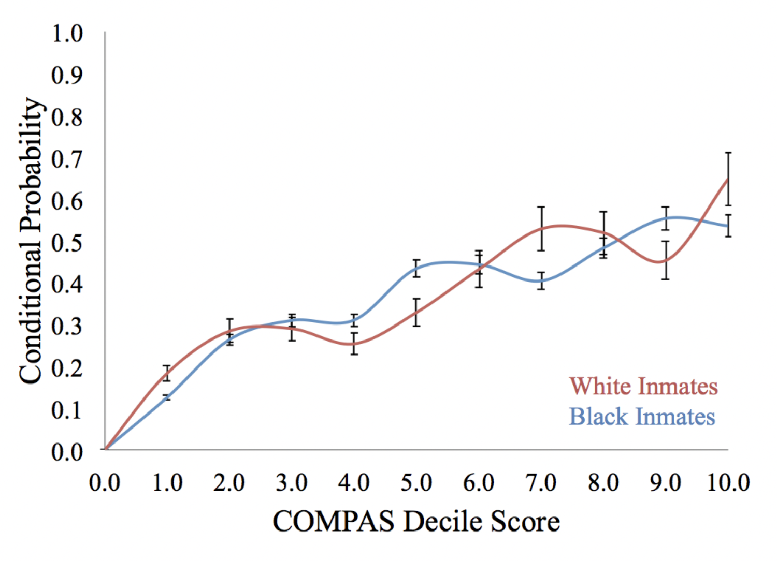
Wadsworth et al., 2018

Slide 40
How did COMPAS learn to discriminate?
Data used to create COMPAS risk prediction model came from Level of Service Inventory – Revised (LSI)
A lengthy questionnaire created by criminologists for the prisoner to fill out, with questions like
“How many prior arrests have you had?”
“What part did alcohol and drugs play?”
“The first time you were involved with the police?”
(Historical bias) The questions themselves discriminate against minority classes and contribute to the feedback loop amplifying bias

Slide 41
Case study: Crowdsourcing science

Slide 42
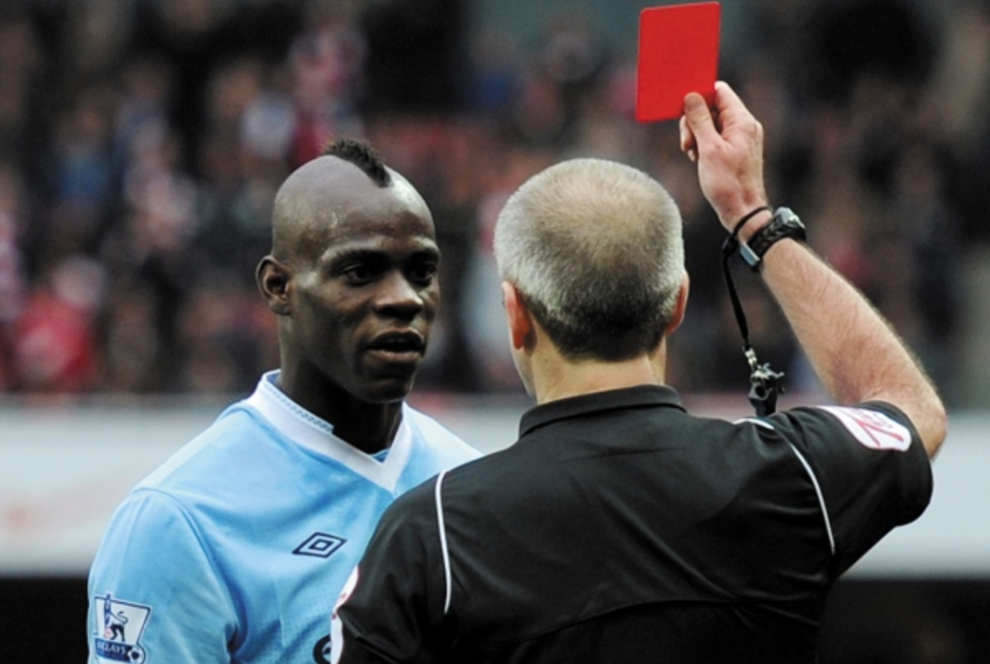
Do soccer players with darker skin tones get more red cards?
29 teams
Same data
Different analytic choices

Slide 43
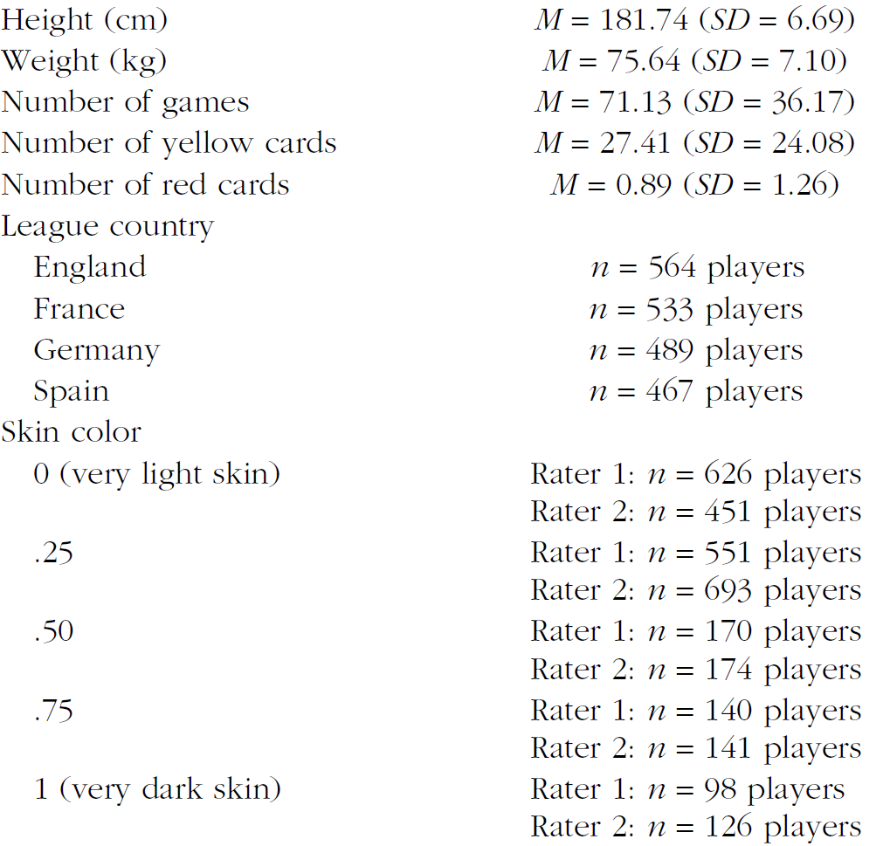
Data
All teams were given the same data set collected by a sports-statistics firm across four major football leagues, games, years, referees, players.
Referee calls, counts of how often referees encountered each player, and player demographics including team position, height and weight.
Includes a rating of players' skin color, coded manually:
two independent coders sorted photographs of players into five categories ranging from 'very light' to 'very dark' skin tone.

Slide 44
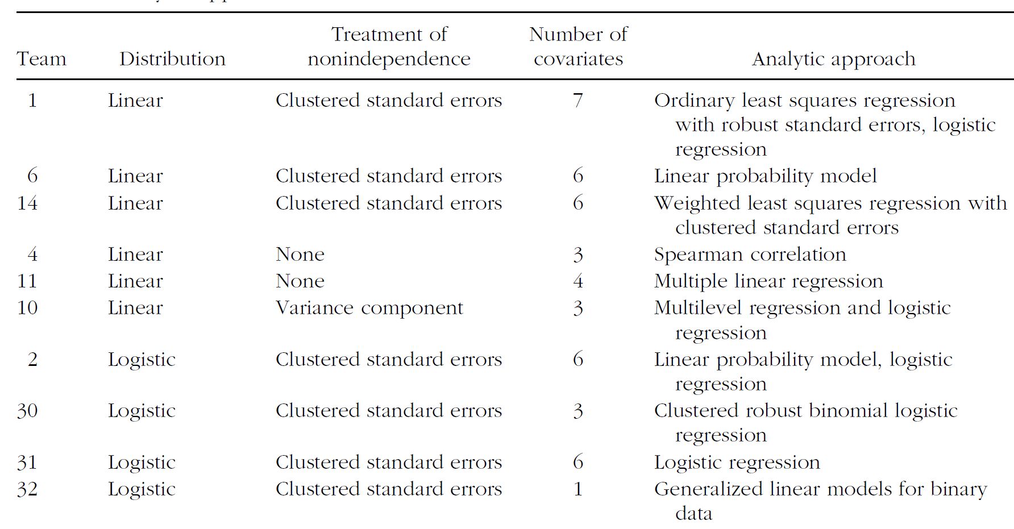
Different analytic choices: modeling approach

Slide 45
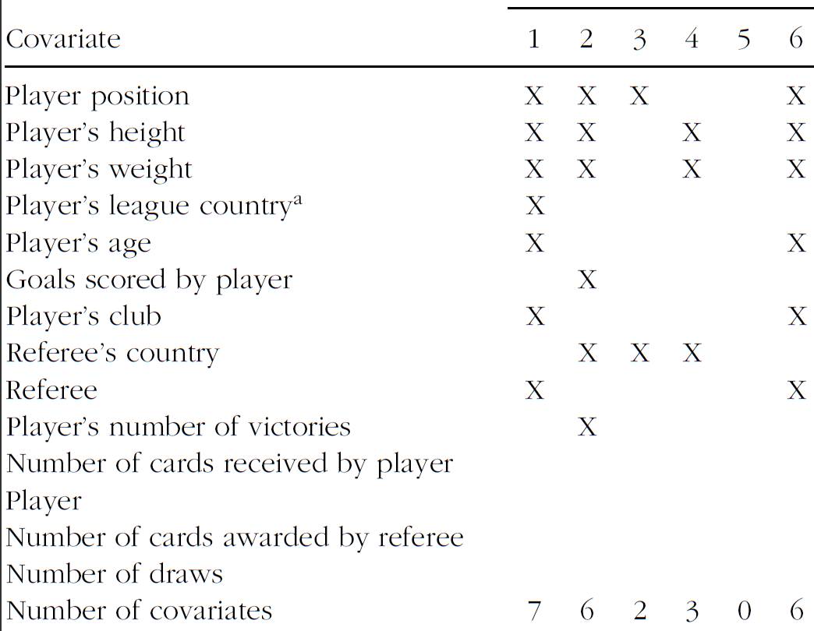
Different analytic choices: covariates used
…

Slide 46
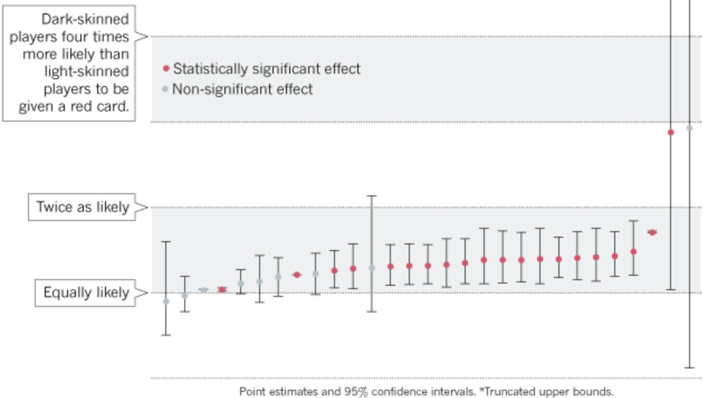
Odds ratio of red-carding a darker player

Slide 47
Best practices

Slide 48
Best practices for data ethics
Keep Data Ethics in the Spotlight
Data ethics is a pervasive aspect of data practices
Consider the Human Lives and Interests Behind the Data
Data are being collected for important human purposes and interests
Focus on Downstream Risks and Uses of Data
What happens to or with the data later on, even after it leaves our hands.
Where the data might be five or ten years from now? In whose hands? For what purposes? And with what safeguards?
Avoid Dangerous Hype and Myths around ‘Big Data’
Data is powerful, but it isn’t a silver bullet for complex social problems.
Digital “snake oil” can create unmet hopes and expectations that lead to consumer and media backlash
Promote Values of Transparency, Autonomy, and Trustworthiness
Clear and understandable data collection, use, and privacy policies. Favoring ‘opt-in’ rather than ‘opt-out’ options and offering choice for data participants can enhance autonomy and transparency, and promote greater trust.

Slide 49
Best practices for data ethics
Consider Disparate Interests, Resources, and Impacts
Understand the profound risk in many data practices of producing or magnifying disparate impacts; that is, of making some people better off and others worse off, whether this is in terms of their social share of economic well-being, political power, health, justice
Invite Diverse Stakeholder Input
Invite input from diverse stakeholders outside of the team and organization.
Design for Privacy and Security
data privacy and security remain at the forefront of project design, planning, execution, and oversight, and are never treated as marginal, external, or ‘after-the-fact’ concerns.
Make Ethical Reflection & Practice Standard, Pervasive, Iterative, and Rewarding

Slide 50
Best practices for data ethics
Quantitative methods to reduce bias in AI (this course)
General Machine Learning
Classification
Regression
Structured prediction
Graphs
Representation Learning
Variational Autoencoders
Natural Language Processing
Word Embeddings
Coreference Resolution
Machine Translation
Mehrabi, N., Morstatter, F., Saxena, N., Lerman, K., & Galstyan, A. (2021). A survey on bias and fairness in machine learning. ACM Computing Surveys (CSUR), 54(6), 1-35.

Slide 51
Case study

Slide 52
Case study
Fred and Tamara are applying for a business loan to help them open their own restaurant.
Fred is a graduate of a prestigious culinary school, and
Tamara is an accomplished accountant.
Outside consultants say that Fred and Tamara should be able to easily get a loan
F&T’s bank officer uses software to predict who should get a loan
Data: information about Fred and Tamara’s lives that goes well beyond what they were asked to disclose on their loan application
on-time bill payment history
drugstore purchases (likely medical histories),
Genetic risk factors of extended family
data about the books they read and the movies they watch, and
inferences about their racial background
Data has variable accuracy

Slide 53
Loan was not approved
Prediction: moderate-to-high risk
No explanation of prediction!
Is data accurate?
Does model pick up spurious correlations?
Even system designers do not know (but system is “generally” reliable)
Deterministic prediction, no way to re-evaluate decision

Slide 54
Questions
What ethically significant harms might Fred and Tamara have suffered as a result of their loan denial?

Slide 55
Questions
What ethically significant harms might Fred and Tamara have suffered as a result of their loan denial?
What sort of ethically significant benefits could come from banks using a big-data driven system to evaluate loan applications?

Slide 56
Questions
What ethically significant harms might Fred and Tamara have suffered as a result of their loan denial?
What sort of ethically significant benefits could come from banks using a big-data driven system to evaluate loan applications?
Beyond the impacts on Fred and Tamara’s lives, what broader harms to society could result from the widespread use of this particular loan evaluation process?

Slide 57
Questions
What ethically significant harms might Fred and Tamara have suffered as a result of their loan denial?
What sort of ethically significant benefits could come from banks using a big-data driven system to evaluate loan applications?
Beyond the impacts on Fred and Tamara’s lives, what broader harms to society could result from the widespread use of this particular loan evaluation process?
What measures could the loan officer, the bank’s managers, or the employees of the software company have taken to lessen or prevent those harms?

Slide 58
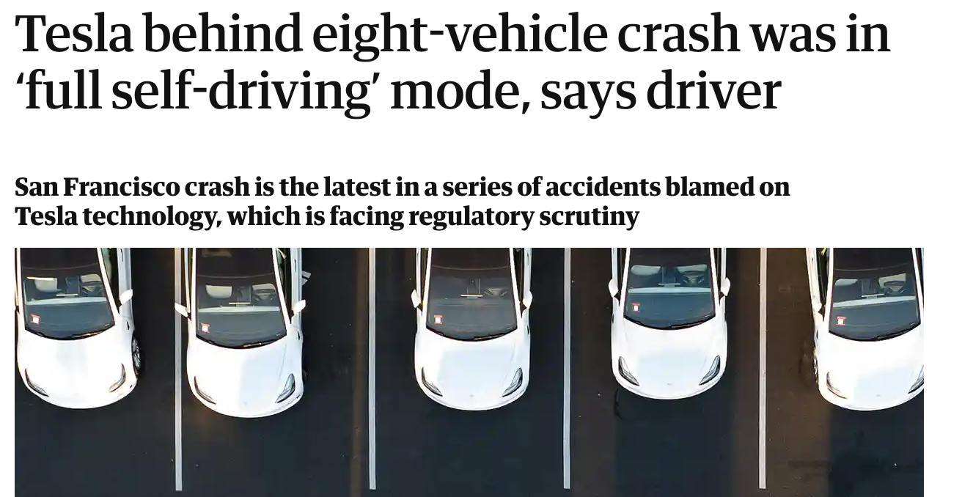
AI ethics are diverse, go beyond AI fairness

Slide 59
Ethical questions
Who is ethically responsible?
The AI engineer for making an unreliable self-driving car?
The car itself?
The situation?
The driver for putting trust in an unreliable system?
Was it moral to create an imperfect self-driving car?
What is the best way to make AI so that it improves our lives?

Slide 60
Summary
Ethics : how to live the best life (for you, for society, etc.)
Ethics and AI
AI has broad individual & society impacts
AI can create many harms and benefits
Ethical challenges:
AI -> users -> data -> AI
Ethics of data - privacy & biases in data
Impact on users
AI can discriminate
COMPAS - unfair decisions
Models are based on unfair data
AI ethics go beyond fairness (out of scope) but are important to think about

